Slide 1
Probabilistic Models for Supervised Learning: Logistic Regression, Generative Classification, Discriminative vs Generative
CSN-382

Slide 2
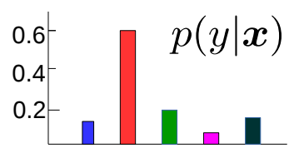




Probabilistic Models for Supervised Learning
Goal: Learn the conditional distribution of output given input, i.e., $p(y|x)$
$p(y|x)$ is more informative than a single prediction $y$
From $p(y|x)$, can get “expected” or “most likely” output $y$
For classifn, “soft” predictions (e.g., rather than yes/no, prob. of “yes”)
“Uncertainty” in the predicted output $y$ (e.g., by looking at the variance of $p(y|x)$)
Can also learn a distribution over the model params using fully Bayesian inference
Probabilistic Linear Regression
Probabilistic Classification
$$p(y|x)$$
$$w^{⊤}x (mean)$$
$$y$$
Such uncertainty also helps in “active learning” where we wish to identify “difficult” (and hence more useful) training examples

Slide 3

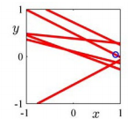
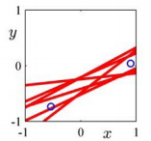
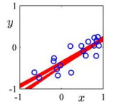


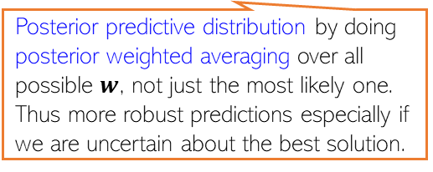
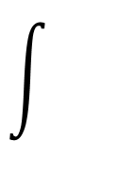
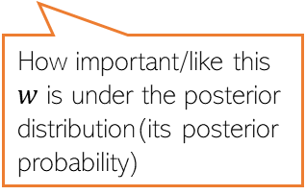


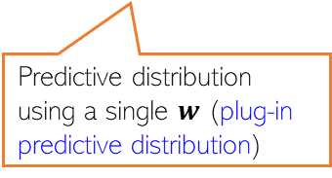
Distribution over model parameters??
Recall that linear/ridge regression gave a single “optimal” weight vector
With a probabilistic model for linear regression, we have two options
Use MLE/MAP to get a single “optimal” weight vector
Use fully Bayesian inference to learn a distribution over weight vectors (figure below)
Rather than returning just a single “best” solution (a line in this example), the fully Bayesian approach would give us several “probable” lines (consistent with training data) by learning the full posterior distribution over the model parameters (each of which corresponds to a line)
One training ex
Two training ex
A few more training ex
$$p\left(y_{∗}\right|X,y)=$$
$$p\left(y_{∗} | w,x\right)$$
$$p\left(w | X,y\right)$$
$$dw$$
In this course, we will mostly focus on probabilistic ML when using MLE/MAP and predictive distributions computed using a single best estimate (MLE/MAP).
Posterior predictive distribution by doing posterior weighted averaging over all possible $w$, not just the most likely one. Thus more robust predictions especially if we are uncertain about the best solution.
How important/like this $w$ is under the posterior distribution(its posterior probability)
Predictive distribution using a single $w$ (plug-in predictive distribution)

Slide 4



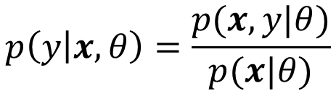
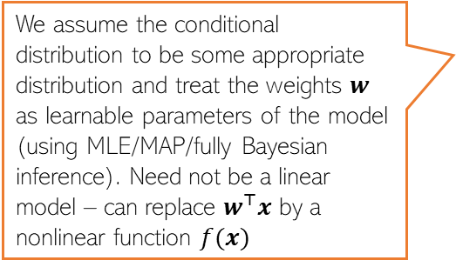

Probabilistic Models for Supervised Learning
Usually two ways to model the conditional distribution $p(y|x)$
Approach 1: Don’t model $x$, and model $p(y|x)$ directly using a prob. distribution
Approach 2: Model both $x$ and $y$ via their joint distr. and get the conditional as
“discriminative” sup learning
Gaussian distribution
We assume the conditional distribution to be some appropriate distribution and treat the weights $w$ as learnable parameters of the model (using MLE/MAP/fully Bayesian inference). Need not be a linear model – can replace $w^{⊤}x$ by a nonlinear function $f(x)$
$$p\left(y | x,w\right)=𝒩(y|w^{⊤}x,β^{−1})$$
Probabilistic linear regression
The “sigmoid” function
$$p\left(y | x,w\right)=Bernoulli(y|{σ(w}^{⊤}x))$$
Probabilistic linear binary classification
Here $θ$denotes all the model parameters that we need to model the joint distribution of $x$ and $y$
“generative” sup learning
$$p\left(y | x,θ\right)=\frac{p(x,y|θ)}{p(x|θ)}$$
Prob. distribution of inputs from class $k$
Called “generative” because we are learning the generative distributions for output as well as inputs
$p\left(y=k | x,θ\right)=\frac{p(x,y=k|θ)}{p(x|θ)}$ $=\frac{p\left(x | y=k,θ\right)p(y=k|θ)}{\sum_{ℓ=1}^{K}{p\left(x | y=ℓ,θ\right)p(y=ℓ|θ)}}$
For a multi-class classification model with $K$ classes

Slide 5
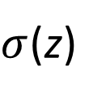
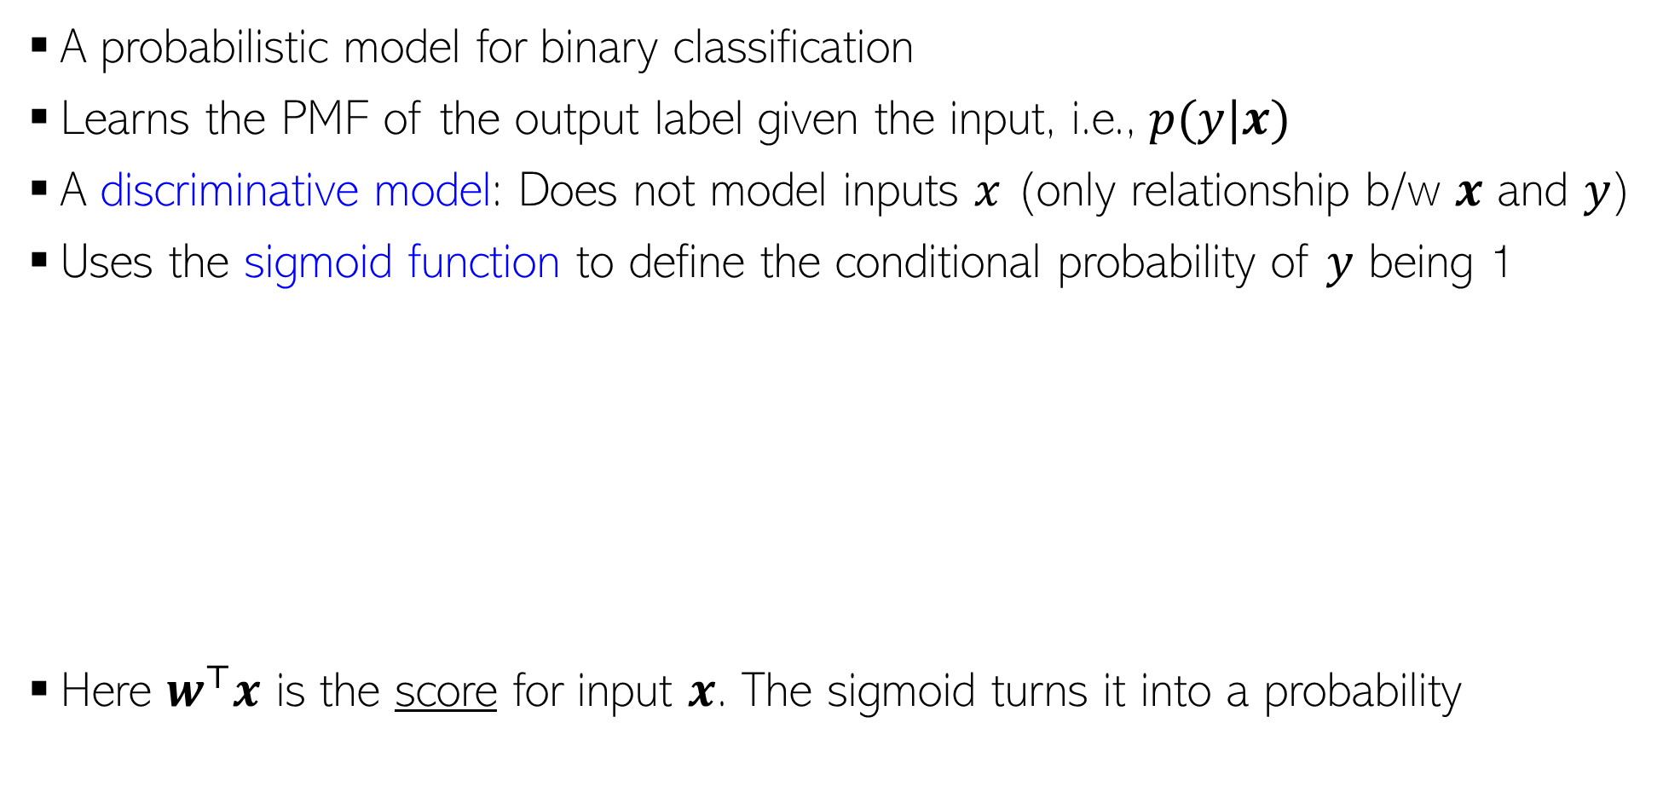

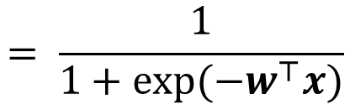


Logistic Regression (LR)
Both very widely used
Multi-class extension known as “softmax regression”
The word “regression” is a misnomer. Both are classification models
A probabilistic model for binary classification
Learns the PMF of the output label given the input, i.e., $p(y|x)$
A discriminative model: Does not model inputs $x$ (only relationship b/w $x$ and $y$)
Uses the sigmoid function to define the conditional probability of $y$ being 1
Here $w^{⊤}x$ is the score for input $x$. The sigmoid turns it into a probability
$$μ_{x}=p\left(y=1 | w,x\right)=σ(w^{⊤}x)$$
$σ$(z)
1
$$= \frac{1}{1+exp(−w^{⊤}x)}$$
0.5
$$= \frac{exp(w^{⊤}x)}{1+exp(w^{⊤}x)}$$
A linear model
0
$$\text{z}$$

Slide 6
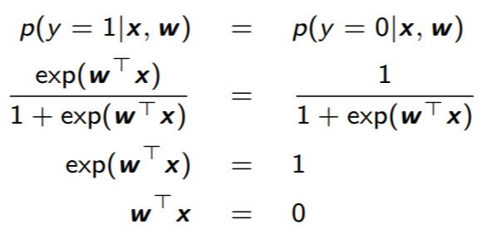
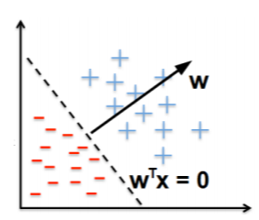

LR: Decision Boundary
At the decision boundary where both classes are equiprobable
Very large positive $w^{⊤}x$ means $p\left(y=1 | w,x\right)$ close to 1
Very large negative $w^{⊤}x$ means $p\left(y=0 | w,x\right)$ close to 1
At decision boundary, $w^{⊤}x$ = 0 implies $p\left(y=1 | w,x\right)$ = $p\left(y=0 | w,x\right)$ = 0.5
A linear hyperplane

Slide 7
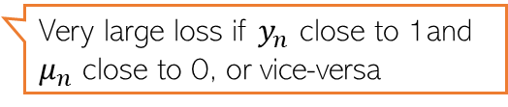
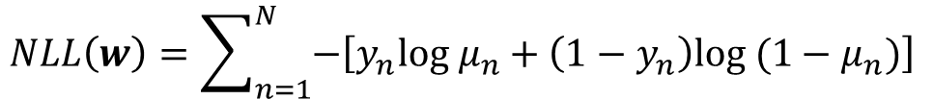
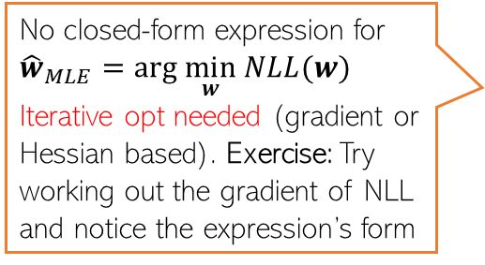

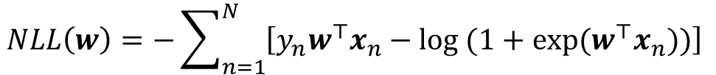
MLE for Logistic Regression
Assumed 0/1, not -1/+1
Likelihood (PMF of each input’s label) is Bernoulli with prob $μ_{n}=\frac{exp(w^{⊤}x_{n})}{1+exp(w^{⊤}x_{n})}$
Overall likelihood, assuming i.i.d. observations
The negative log-likelihood $NLL\left(w\right)=−log p\left(y | w,X\right)$ simplifies to
Plugging in $μ_{n}=\frac{exp(w^{⊤}x_{n})}{1+exp(w^{⊤}x_{n})}$ and simplifying
$$p\left(y_{n} | w,x_{n}\right)=Bernoulli\left(μ_{n}\right)=μ_{n}^{y_{n}}{(1−μ_{n})}^{1−y_{n}}$$
$$p\left(y | w,X\right)=\prod_{n=1}^{N}{p\left(y_{n} | w,x_{n}\right)=\prod_{n=1}^{N}{μ_{n}^{y_{n}}{(1−μ_{n})}^{1−y_{n}}}}$$
“cross-entropy” loss (a popular loss function for classification)
Loss function
$$NLL\left(w\right)=\sum_{n=1}^{N}{−\left[y_{n}log μ_{n}+\left(1−y_{n}\right)log (1−μ_{n})\right]}$$
Very large loss if $y_{n}$ close to 1and $μ_{n}$ close to 0, or vice-versa
Good news: For LR, NLL is convex
No closed-form expression for ${\hat{w}}_{MLE}=arg \min_{w} NLL(w)$
Iterative opt needed (gradient or Hessian based). Exercise: Try working out the gradient of NLL and notice the expression’s form
$$NLL\left(w\right)=−\sum_{n=1}^{N}{\left[y_{n}w^{⊤}x_{n}−log (1+exp(w^{⊤}x_{n}))\right]}$$
Notes:
U_n is equal to P(y = 1 | x) which is already calculated for LR

Slide 8

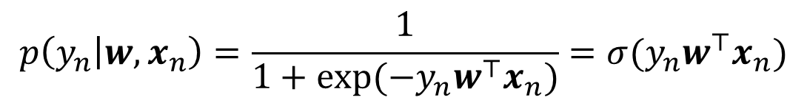
An Alternate Notation
If we assume the label $y_{n}$ as -1/+1 (not 0/1), the likelihood can be written as
Slightly more convenient notation: A single expression gives the probabilities of both possible label values
In this case, the total negative log-likelihood will be
$$p\left(y_{n} | w,x_{n}\right)=\frac{1}{1+exp(−y_{n}w^{⊤}x_{n})}=σ(y_{n}w^{⊤}x_{n})$$
$NLL\left(w\right)= \sum_{n=1}^{N}{−log p\left(y_{n} | w,x_{n}\right)=}$ $\sum_{n=1}^{N}{log (1+exp\left(−y_{n}w^{⊤}x_{n}\right))}$

Slide 9








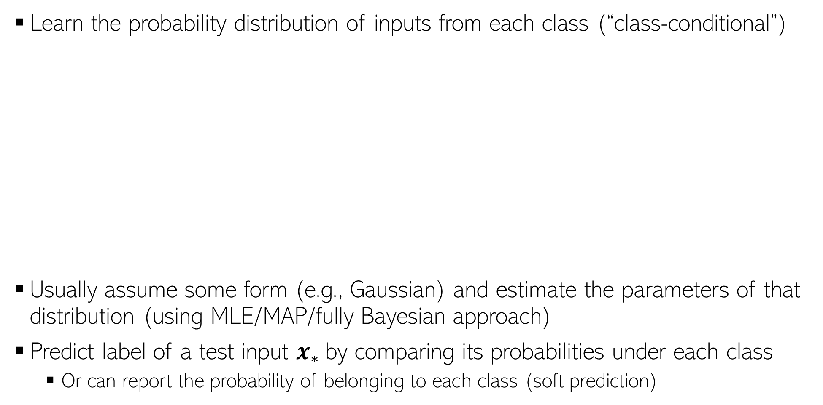

Generative Classification: A Basic Idea
Learn the probability distribution of inputs from each class (“class-conditional”)
Usually assume some form (e.g., Gaussian) and estimate the parameters of that distribution (using MLE/MAP/fully Bayesian approach)
Predict label of a test input $x_{∗}$by comparing its probabilities under each class
Or can report the probability of belonging to each class (soft prediction)
Yes. We can do it by incorporating class prior probabilities (proportion of each class in the training data) in our model
What if I a priori expect that the red class is more likely for a test input because the training data also had more red examples?
$$p(x|"red")$$
Then we can compute and compare the class posterior probabilities of each class for the test input
$$p(x_{∗}|class)$$
$$p(x_{∗}|class)$$
$$p(x|"green")$$
Can I incorporate that knowledge?
$$p(x_{∗}|class)$$
Going to talk about this next
$$x_{∗}$$
$$x_{∗}$$
$$x_{∗}$$

Slide 10


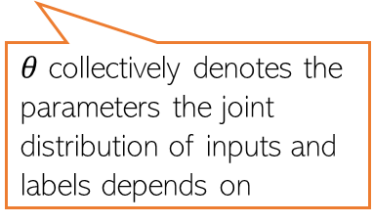
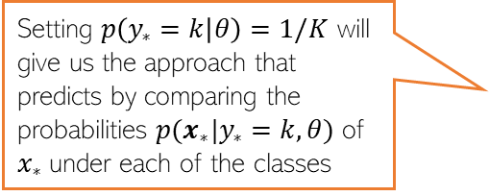
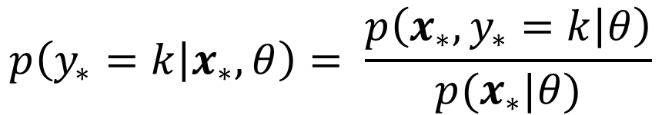

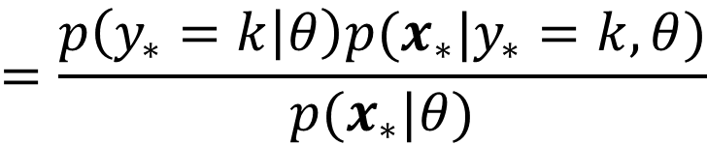
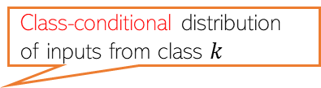
Generative Classification: More Generally..
Roughly speaking, what’s the fraction of each class in the training data
Consider a classification problem with $K ≥ 2$classes
The class prior probability of each class $k∈ \{1,2,…,K\}$ is $p(y=k)$
Can use Bayes rule to compute class posterior probability for a test input $x_{∗}$
We will first estimate the parameters of class prior and class-conditional distributions. Once estimated, we can use the above rule to predict the label for any test input
Can use MLE/MAP/fully Bayesian approach. We will only consider MLE/MAP here
Class prior distribution for class $k$
Class-conditional distribution of inputs from class $k$
$$p\left(y_{∗}=k | x_{∗},θ\right)= \frac{p\left(x_{∗},y_{∗}=k | θ\right)}{p(x_{∗}|θ)}$$
$$=\frac{p\left(y_{∗}=k | θ\right)p(x_{∗}|y_{∗}=k,θ)}{p(x_{∗}|θ)}$$
$θ$ collectively denotes the parameters the joint distribution of inputs and labels depends on
Setting $p\left(y_{∗}=k | θ\right)=1/K$ will give us the approach that predicts by comparing the probabilities $p(x_{∗}|y_{∗}=k,θ)$ of $x_{∗}$under each of the classes
This is just the marginal distribution of the joint distribution in the numerator (summed over all $K$ values of $y_{∗}$)

Slide 11
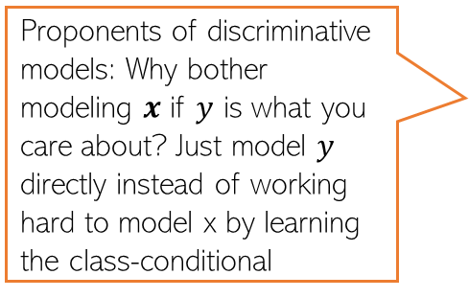
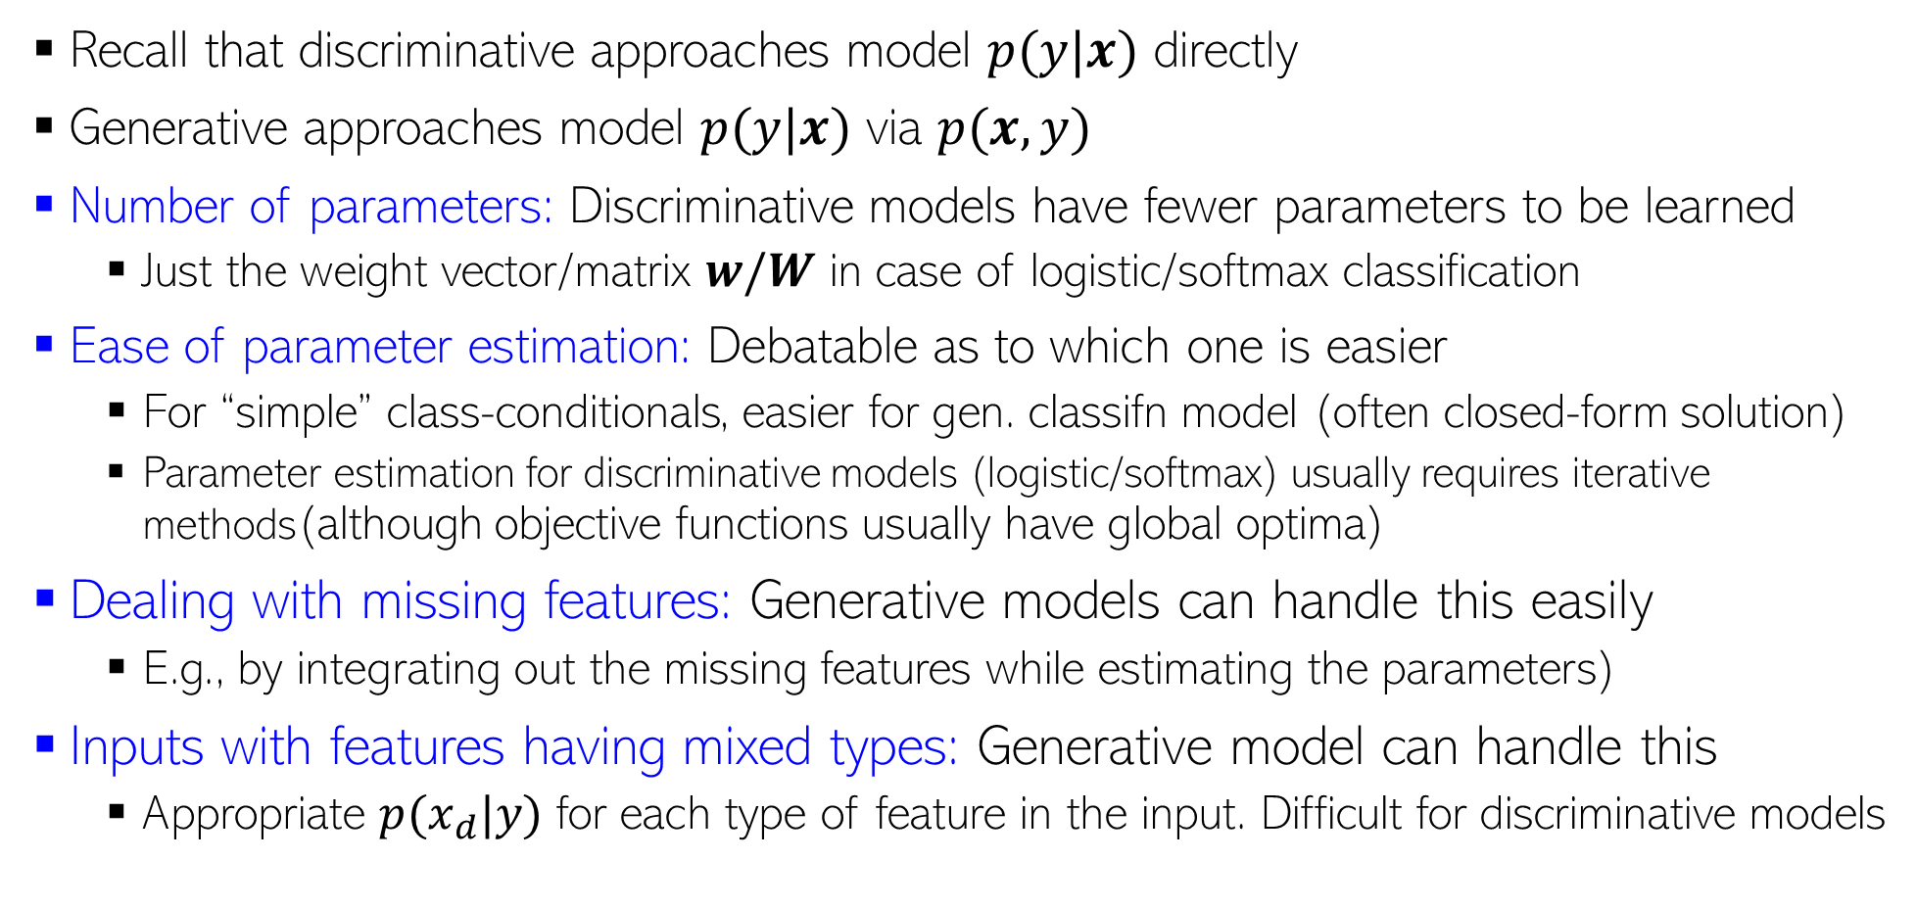
Discriminative vs Generative
Proponents of discriminative models: Why bother modeling $x$ if $y$ is what you care about? Just model $y$ directly instead of working hard to model x by learning the class-conditional
Recall that discriminative approaches model $p(y|x)$ directly
Generative approaches model $p(y|x)$ via $p(x,y)$
Number of parameters: Discriminative models have fewer parameters to be learned
Just the weight vector/matrix $w/W$ in case of logistic/softmax classification
Ease of parameter estimation: Debatable as to which one is easier
For “simple” class-conditionals, easier for gen. classifn model (often closed-form solution)
Parameter estimation for discriminative models (logistic/softmax) usually requires iterative methods(although objective functions usually have global optima)
Dealing with missing features: Generative models can handle this easily
E.g., by integrating out the missing features while estimating the parameters)
Inputs with features having mixed types: Generative model can handle this
Appropriate $p(x_{d}|y)$ for each type of feature in the input. Difficult for discriminative models

Slide 12
Discriminative vs Generative (Contd)
Leveraging unlabeled data: Generative models can handle this easily by treating the missing labels are latent variables and are ideal for Semi-supervised Learning. Discriminative models can’t do it easily
Adding data from new classes: Discriminative model will need to be re-trained on all classes all over again. Generative model will just require estimating the class-cond of newly added classes
Have lots of labeled training data? Discriminative models usually work very well
Final Verdict? Despite generative classification having some clear advantages, both methods can be quite powerful (the actual choice may be dictated by the problem)
Important to be aware of their strengths/weaknesses, and also the connections between these
Possibility of a Hybrid Design? Yes, Generative and Disc. models can be combined, e.g.,
“Principled Hybrids of Generative and Discriminative Models” (Lassere et al, 2006)
“Deep Hybrid Models: Bridging Discriminative & Generative Approaches” (Kuleshov & Ermon, 2017)
Notes:
Generative => These models aim to learn the underlying distribution of the data, allowing them to generate new samples that resemble the training data. Examples include Gaussian Mixture Models (GMMs) and Variational Autoencoders (VAEs).
You can say the decision boundary for these type of models is defined as – “where one model becomes more likely”.
Discriminative => These models focus on directly learning the decision boundaries between different classes, aiming to classify new instances accurately. Examples include Logistic Regression and Support Vector Machines (SVMs).
if we had the example of differentiating between a snake and a dog, the classifier would learn the differences between them and classify the input accordingly. It wouldn’t try to learn what makes a snake a snake, and what defines a dog. A generative model, on the other hand, will try to learn the underlying distribution of the classes and classify input accordingly.
Very good example for hybrid architecture is GANs.

Slide 13
Coming up next
Large-margin hyperplane based classifiers (support vector machines)
Kernel methods for learning nonlinear models

